Slide 1

CSE200: Computer Aided Engineering Drawing
Department of Computer Science and Engineering
Md. Mafiul Hasan Matin
Lecturer
Dept. of CSE, East West University

Slide 2
Basics
Three Basic Types of Technical Drawings
– Freehand sketches
– Instrument drawings
– Computer drawings and models
There are two principles in drawing:
Visualization🡪 The ability to see what an object looks like in the mind of eye.
Implementation🡪 Drawing of an object that has been visualized.
Study of drawing can be categorized as
Plane geometry🡪 Representation of an object having two dimensions.
Solid geometry🡪 Representing three dimensions of objects.

Slide 3
Plane Geometry

Slide 4
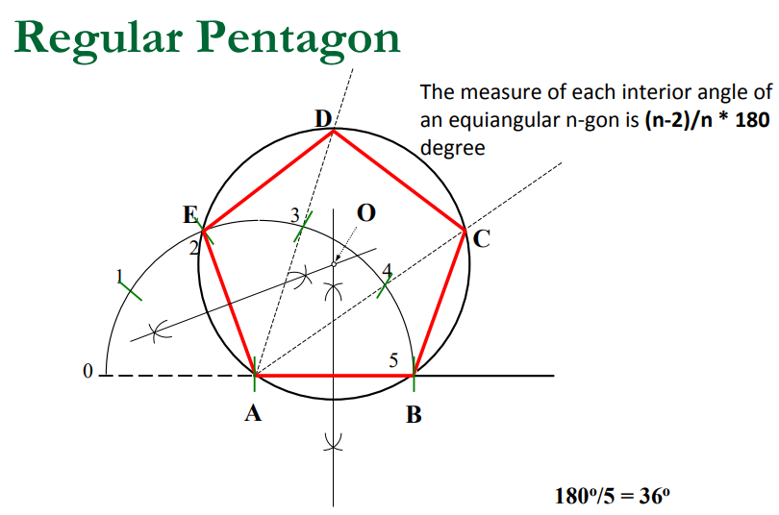

Slide 5
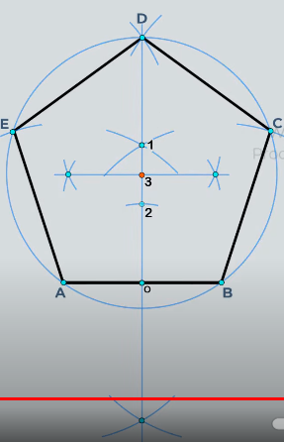
Regular Pentagon
.

Slide 6
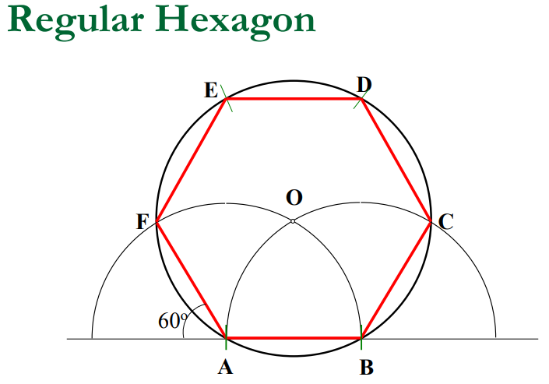

Slide 7
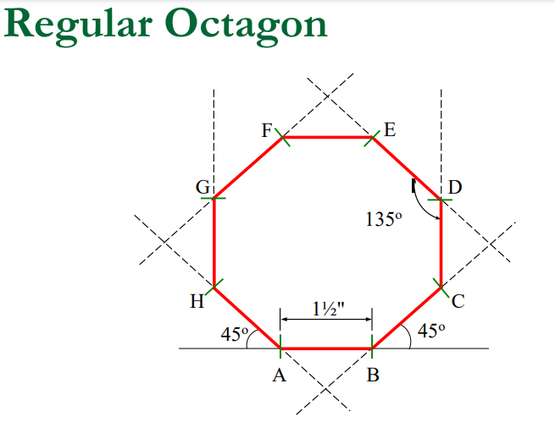

Slide 8
Ellipse
An ellipse has conjugate diameters of 120mm and 80mm, 75 degree is the included angle between them. Using the parallelogram method to draw the ellipse.

Slide 9
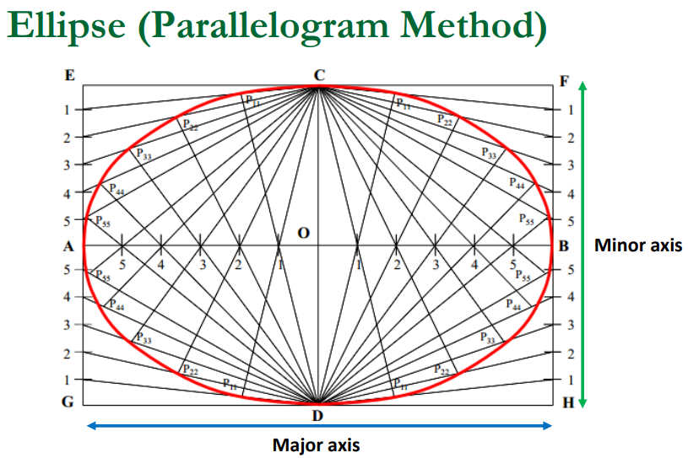

Slide 10
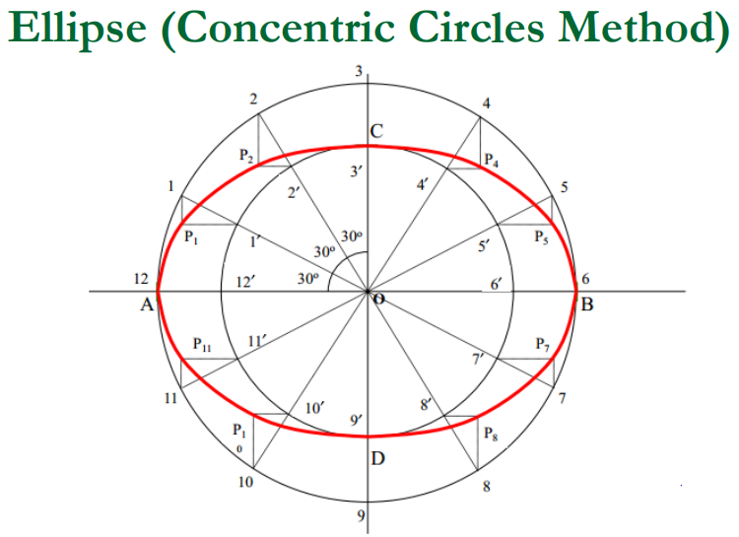

Slide 11
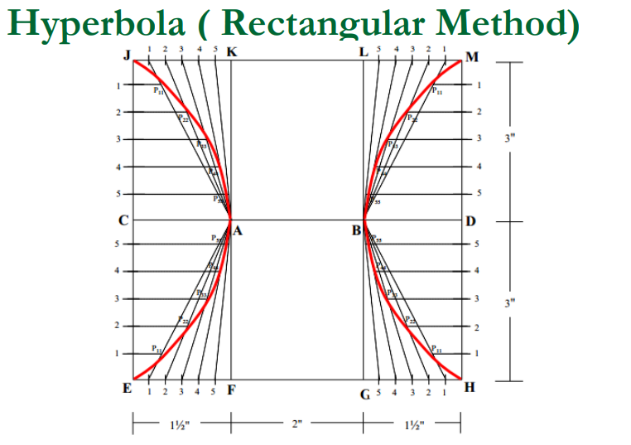

Slide 12
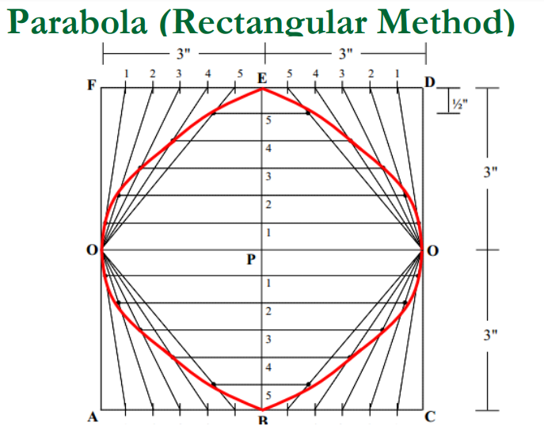

Slide 13
Drawing Instruments: Scales

Slide 14
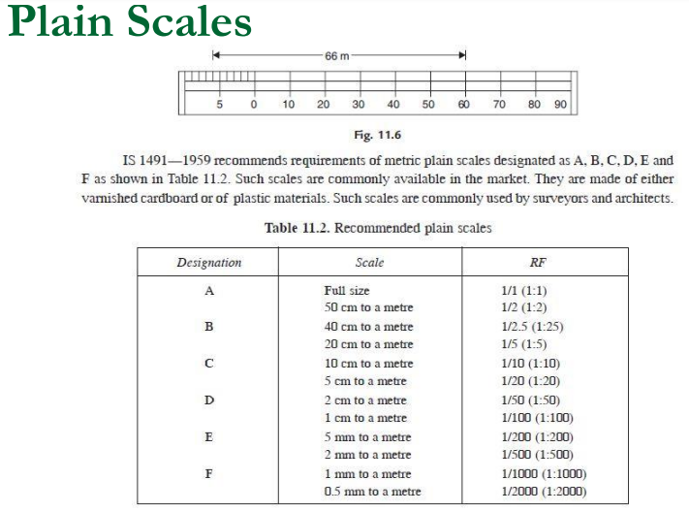

Slide 15
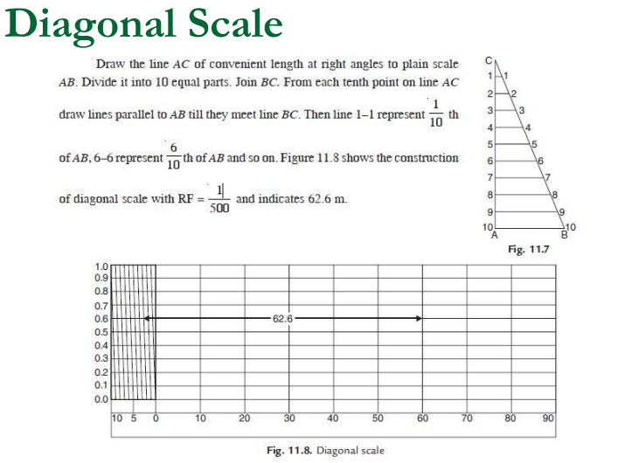

Slide 16
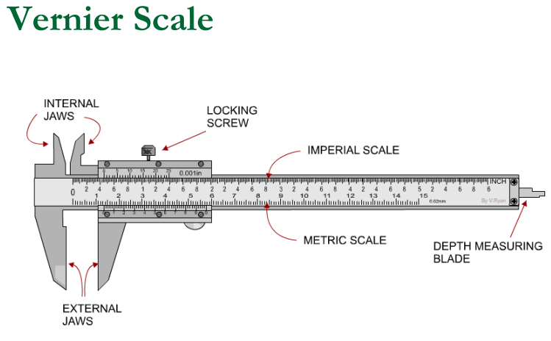

Slide 17
